Slide 1
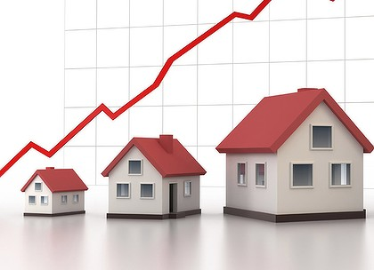
House Price Prediction
Konatala Mohit
Intership-23 , ID-34

Slide 2

Abstract
Introduction
Descriptive Analysis
Data Visualization
Data cleaning and modifying
Feature Selection and Model Training
Conclusion

Slide 3

Abstract
Data analysis and model building on collected data from Surprise Housing to predict the sale price of the House located in Ames city.

Slide 4

In this report I will be discussing about house price prediction using few of the machine learning models via python and its libraries. In today’s era every individual has a keen interest in purchasing house as soon as one lands on a good job in their career. House price prediction helps us to understand how the real estate works i.e., to determine the value of the house property before acquiring or putting it up for a sale to get value for money while making a purchase and decent profit margin while selling the property.

Slide 5

Exploratory Data Analysis
Objective:
Analysis of the data set and summarizing the factor that effect the sale price of the houses.
Understanding the Data Via Descriptive analysis
Size of the data is small contains only 1168 and 292 rows in train and test respectively
Dataset contains 81 for train set and 80 for for test set. SalePrice is the target column

Slide 6
Data contains Null Values in both Train and Test Data
Data contains both numerical and ordinal data
Descriptive analysis is used as it gives the basic value Insite of the data in our dataset.
It helps in organize the data and summarize the data while describing the characteristic of data.

Slide 7
Data Visualization
Data visualization is one simplest way to get a proper idea about the characteristics of the data just from vision. In much simpler words , we Visualize the descriptive stats of the data in pictorial format. Also the data characteristic are represented in eye soothing way
Identifying pattern, understanding is the data is more easier through visuals.

Slide 8
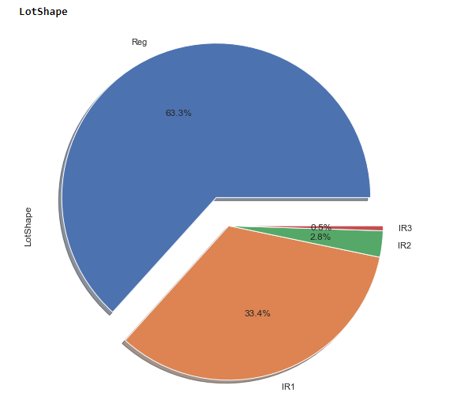
Independent variables influencing the target variable pie chart

Slide 9
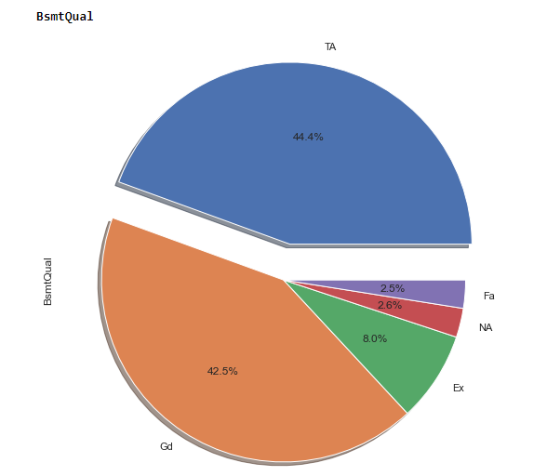
Independent variables influencing the target variable pie chart

Slide 10
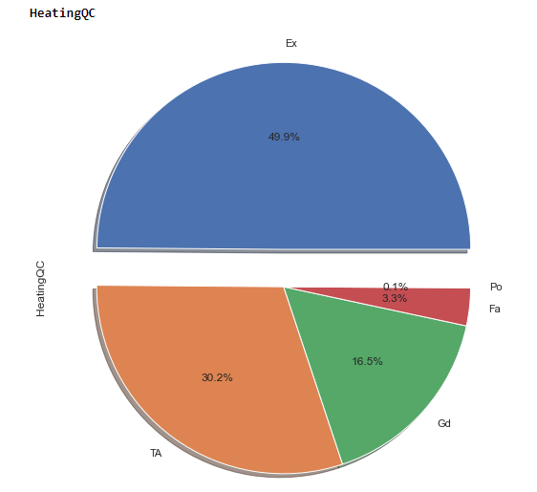
Independent variables influencing the target variable pie chart

Slide 11
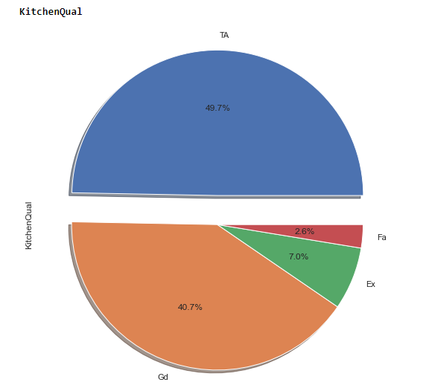
Independent variables influencing the target variable pie chart

Slide 12
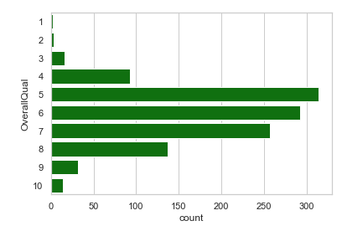
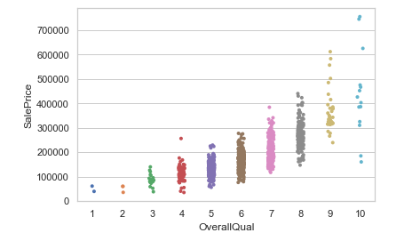
Independent variables influencing the target variable pie chart

Slide 13
Cleaning the Data
Cleaning data is one of the most important procedure in data analysis i.e. detecting and modifying or removing the inaccurate data from the dataset so as improve data quality
Tasks in data cleaning:
Handling null values
Arresting outliers
Removing Skewness if required
Feature Selection and balancing the data

Slide 14
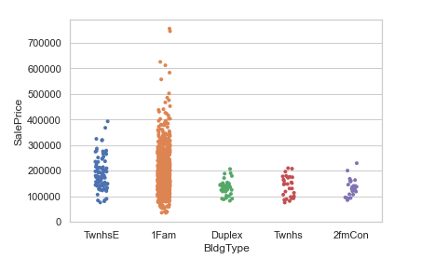
Arresting outliers observed in visualization:
Mostly of the columns have outliers or unique data which are overlapping with other element when looked bi- variate analysis, such are clubbed in one type. Example is shown below.
Feature Selection and Normalization:
Feature selection is done on the basis of corelation (also to remove multi-collinearity) with the target variable and to improve model training. Normalization to remove bias from the data while feeding it to ML.

Slide 15
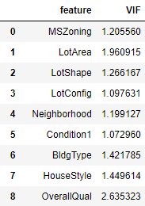
Variance Inflation Factor:
After Normalizing the data and feature selection VIF is used to cross check if there is any existence of multi-collinearity between the independent variable
Note :
VIF and Normalization should done only on independent variables i.e. after splitting the target data column.

Slide 16

Below the keys point in Summarizing the data analysis of House Price Prediction data:
Size of the Dataset is 1161 rows and 35 columns.
No missing values in the dataset.
Converted ordinal data into numerical data
.outliers have been dealt with.
.Feature selection of independent data is done via heatmap and VIF value
.Separate features and prediction variables into two separate list.

Slide 17
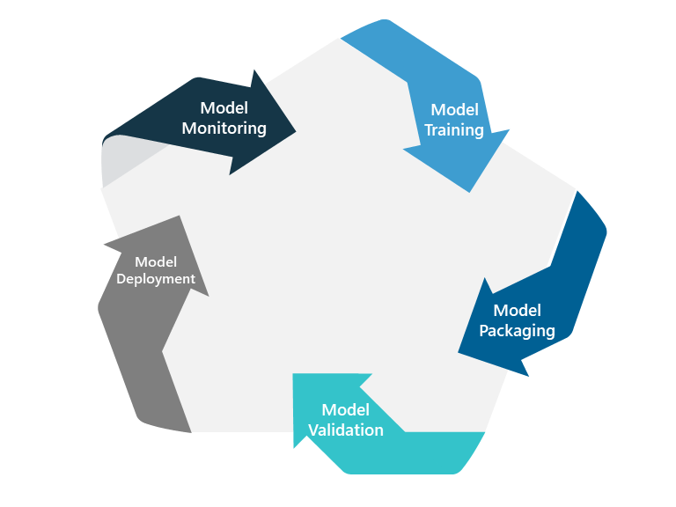
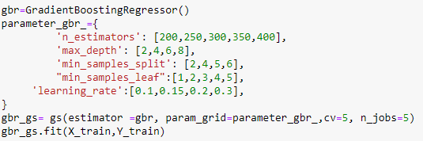
Model Training and Testing
Splitting the Data into Train and Test sets
Using hyperparameter tuning to get the best estimator for the model
Model Training
Cross Validation
Model Testing
Saving the model

Slide 18
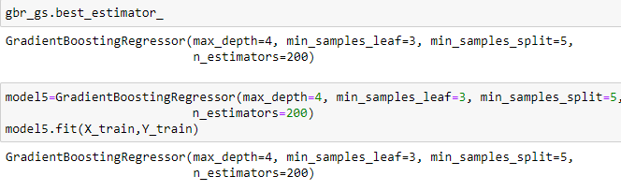
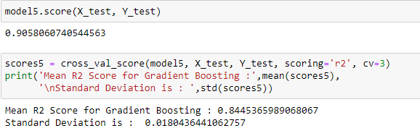

Slide 19
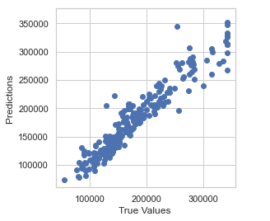

Slide 20

Limitations of this work and Scope for Future Work:
The type sale price predicted are only limited to particular city and neighbourhood. When we try to price of different city the model will fail. When can avoid this if can introduce GDP of the city and type of neighbourhood it is i.e., urban, suburban and rural. Also, distance from the house to main road, highway and city complex. The prediction can also be improved by adding the type of community the house is located in etc.
Conclusion:
In the whole dataset Overall Quality of the house has most influence in the sale price of the house. Total Basement Area, Garage Area, Number of fire places in the house and Lot Area are the other factors which have good influence on the sale price prediction.

